Slide 1
Predict Bitcoin’s price using other cryptocurrencies

Slide 2
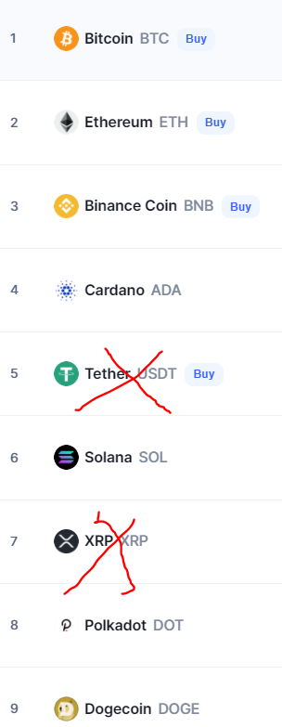
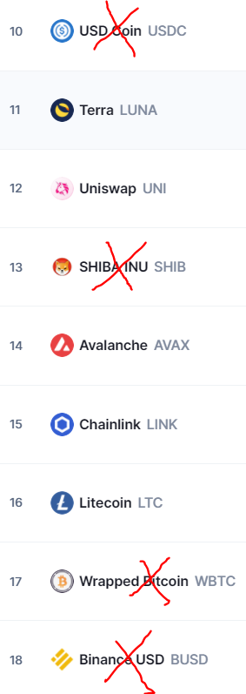

Use LSTM Machine Learning to predict Bitcoin’s price using other cryptocurrencies from the top 20 chart

Slide 3
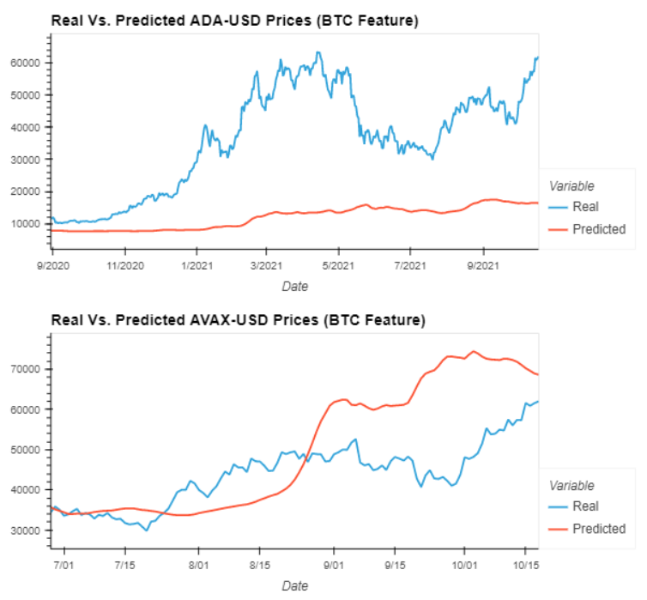
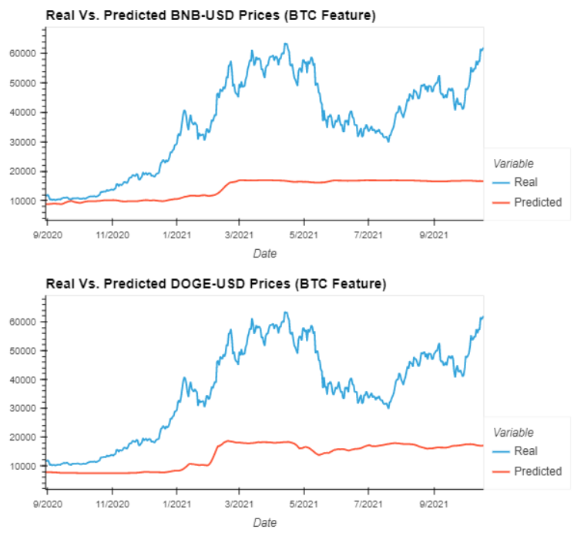
Crypto predicts BTC using 4 Years of Data

Slide 4
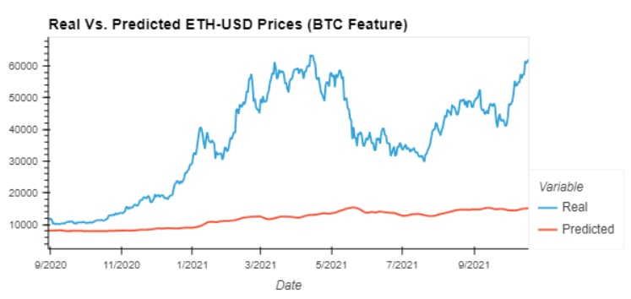
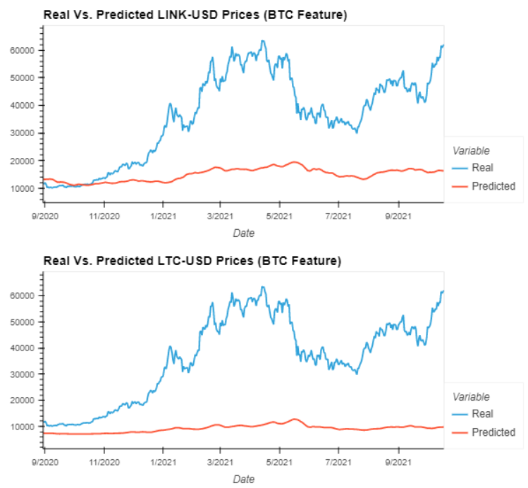
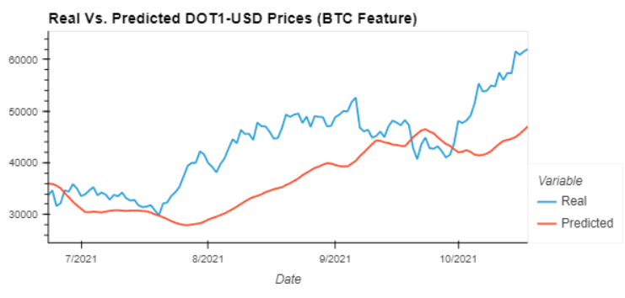
Crypto predicts BTC using 4 Years of Data

Slide 5
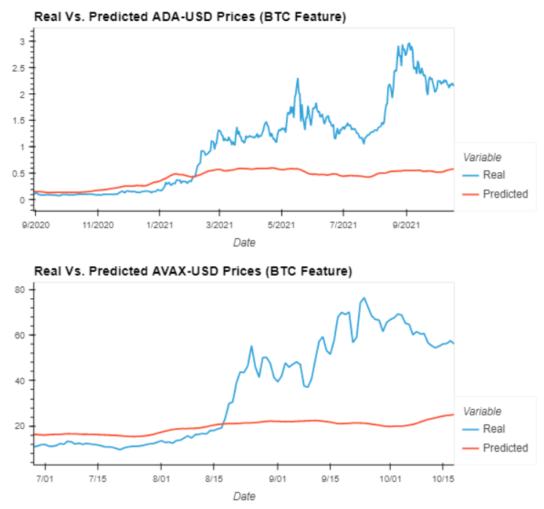
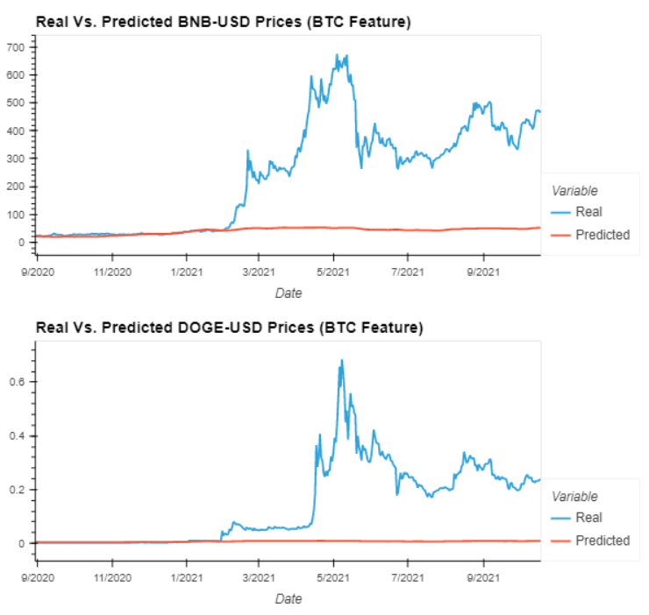
BTC predicts Cryptos using 4 Years of Data

Slide 6
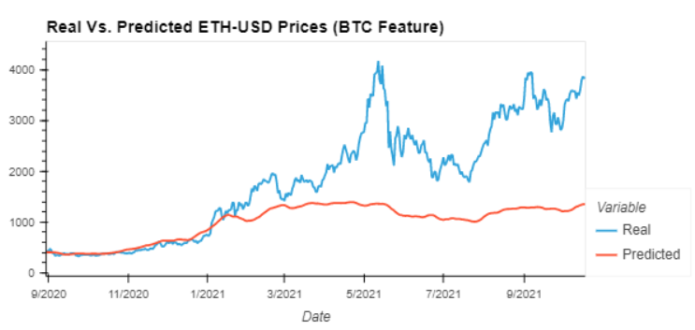
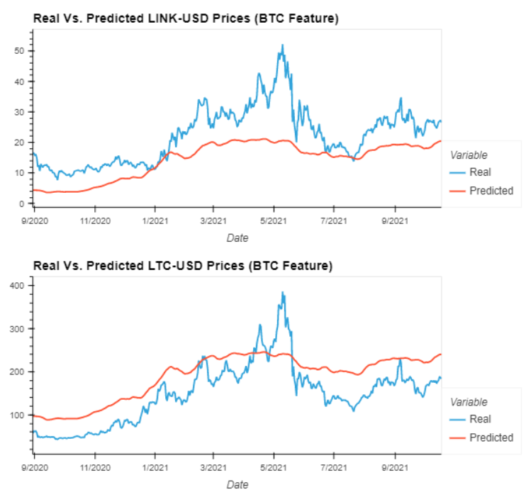
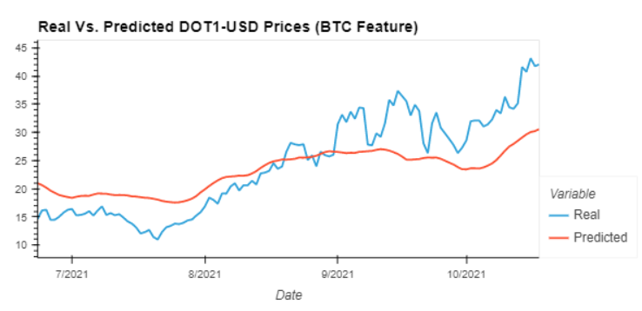
BTC predicts Cryptos using 4 Years of Data

Slide 7
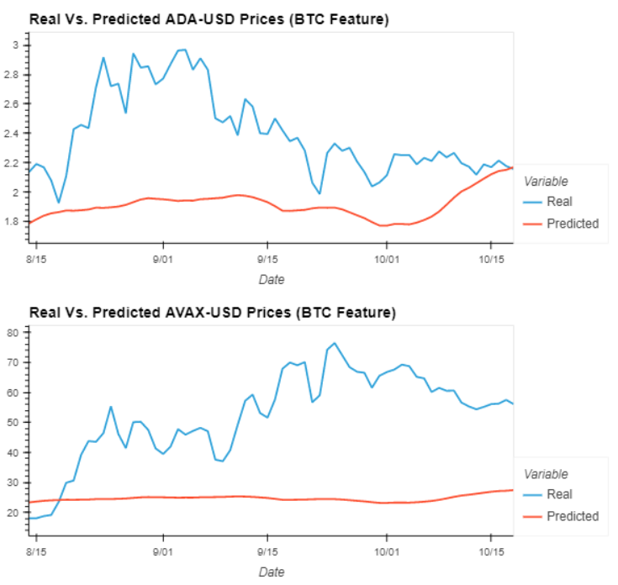
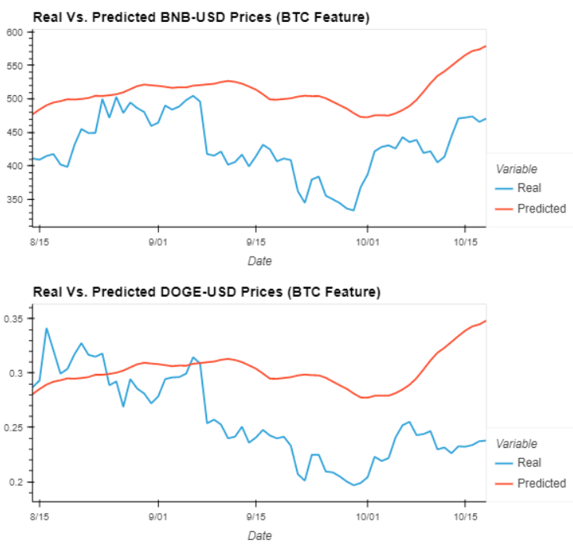
BTC predicts Cryptos using 1 Year of Data

Slide 8
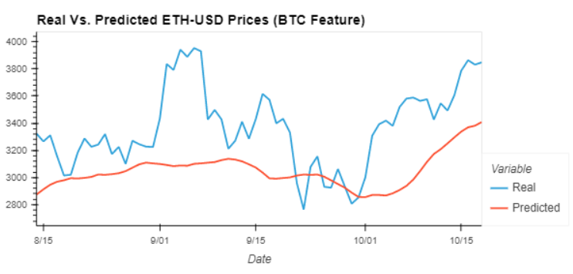
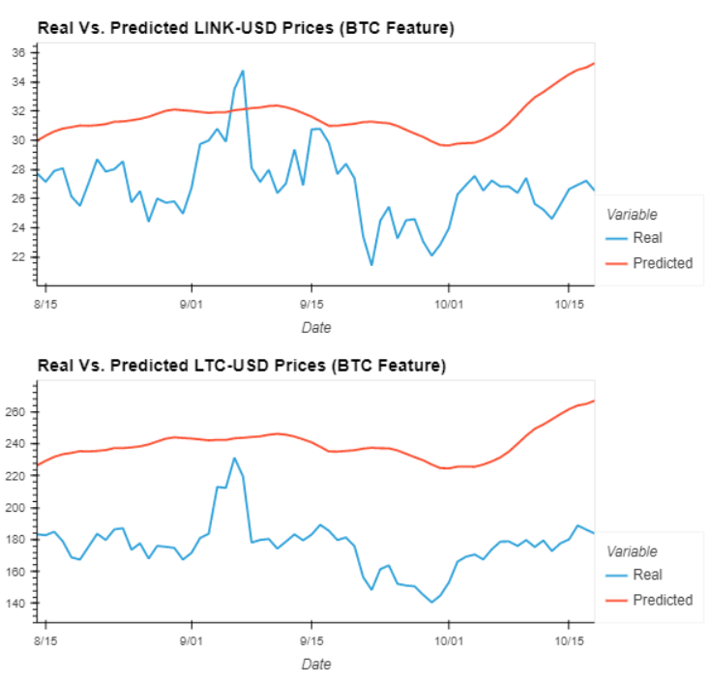
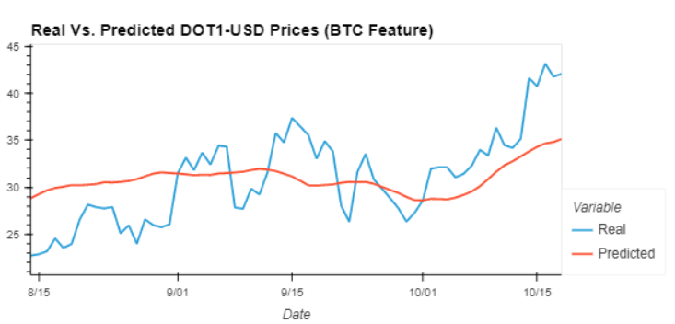
BTC predicts Cryptos using 4 Years of Data

Slide 9
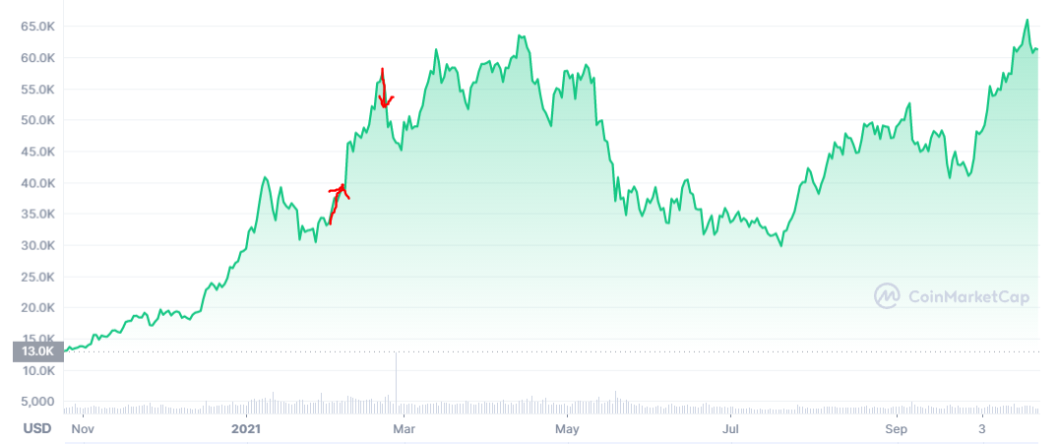
Buy and Sell Trading Algorithm
Strategy : Start with $1000 worth of crypto
At Y% below top
Sell 10% of the value
of your crypto
At X% above bottom
Buy 10% of the value of your crypto

Slide 10
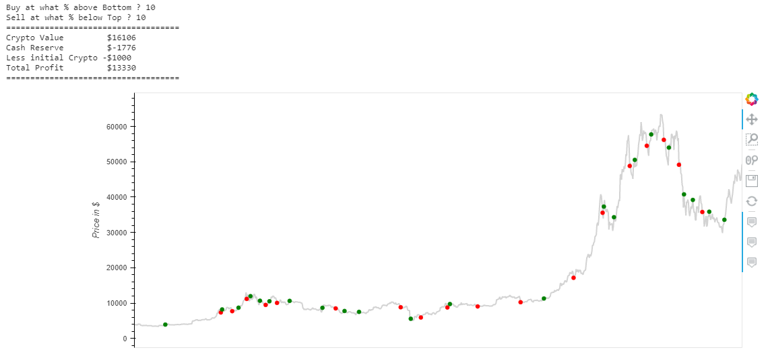

Slide 11
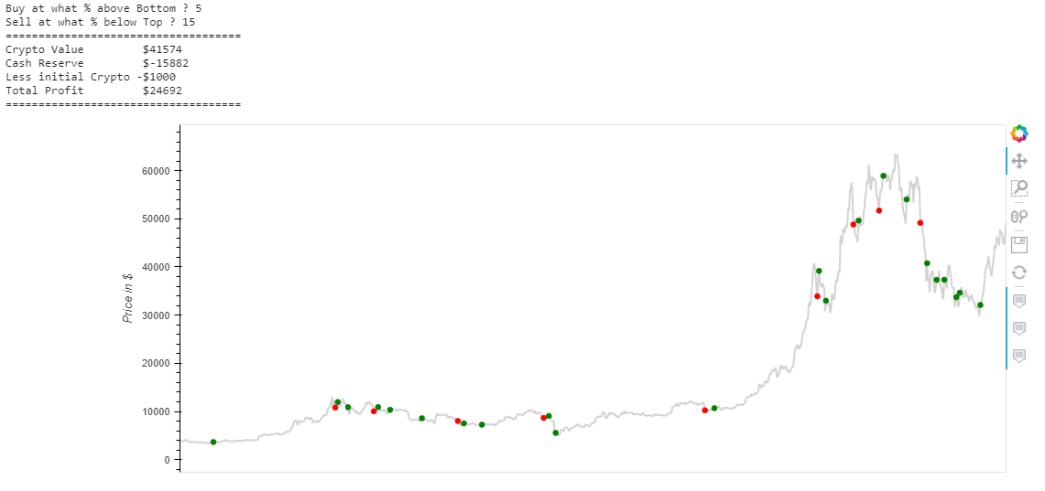

Slide 12
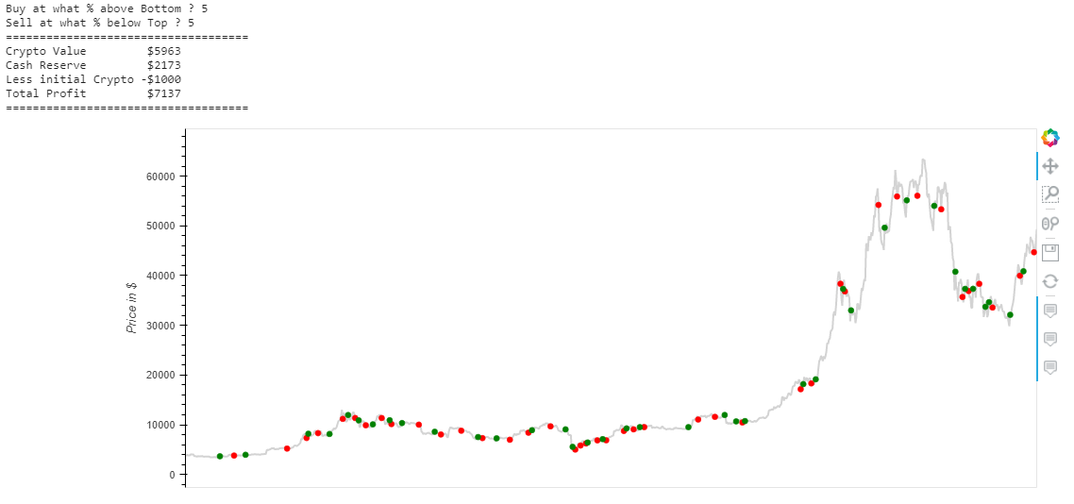

Slide 13
Conclusions
Damien Asset Class Commodities – Gold – Good correlation Asset Class Shares - S&P500 – Strongest correlation Asset Class Shares - Apple– Strong correlation - Terry Sentiment Analysis – Very Effective for Bitcoin Sentiment Analysis – Very Effective for other Cryptos and Shares
Joe Crypto Class –Using Top 20 Cryptos to predict Bitcoin – Poor Correlation
Crypto Class – Using Top 20 Cryptos to predict Bitcoin – 4 years Good Correlation
1 year Data Poor Correlation
Trading Analysis and Tools – 2 effective tools were created to help trade

